Slide 1
Image Correctness For a Product on Marketplace
CSE7101- Capstone Project
Review-3
Batch Number: CIT_10
ROLL NUMBER | STUDENT NAME
20221CIT0048 | B DEEKSHITHA
20221CIT0047 | MANASA T
20221CIT0006 | PR HEMESWAR RAJ
Under the Supervision of,
Guide : Ms.Shivabasamma. Beli
Reviewer : Mr.Tanveer Ahmed
Name of the Program: CSE7101- Capstone Project
Name of the HoD: DrS P Anandaraj Sir
Name of the Program Project Coordinator:
Name of the School Project Coordinators: Dr. Sampath A K , Dr. Geetha A

Slide 2
Abstract:
With the rapid growth of e-commerce marketplaces, the accuracy of product representation has become a critical factor in influencing customer decisions. Product images are the primary interface between the seller and the buyer. Incorrect or misleading images can lead to customer dissatisfaction, returns, and loss of trust. This study focuses on image correctness for products on marketplaces, proposing a system to automatically verify and validate product images against predefined standards. The system ensures that images are clear, high-quality, correctly oriented, and accurately depict the product. Using image processing and machine learning techniques, this framework can detect anomalies, misrepresentations, or guideline violations, thereby enhancing buyer confidence, improving sales conversion rates, and ensuring compliance with marketplace standards.

Slide 3
Literature Review:
Importance of Product Images in E-Commerce
Studies indicate that 75–90% of online buyers rely primarily on product images to make purchase decisions.
Incorrect or misleading images result in higher product return rates and customer complaints.
Image Quality Assessment (IQA)
Traditional methods of IQA rely on metrics like resolution, focus, brightness, and contrast.
Full-reference and no-reference IQA methods have been applied to detect low-quality images in e-commerce.
Image Verification in Marketplaces
Research emphasizes automated verification of images against product metadata using deep learning (CNN-based classifiers) and object recognition.
Systems have been proposed to detect inconsistencies like wrong colors, missing features, or counterfeit items.
Gap Analysis
Most prior systems focus either on image quality or basic object detection.
Few frameworks combine quality assessment, compliance checks, and correctness validation in a unified marketplace environment.

Slide 4
System Design:
The proposed system for image correctness includes three main layers:
Input Layer
  Receives product images uploaded by sellers.
  Metadata such as product name, category, color, size, and description is also inputted.
Processing Layer
  Preprocessing: Resize, normalize, and enhance image quality.
  Feature Extraction: Detect key product attributes using deep learning models (e.g., CNN).
  Validation: Compare detected features with product metadata and marketplace guidelines.
  Quality Checks: Ensure resolution, brightness, orientation, and background standards.
Output Layer
  Provides a correctness report: Acceptable / Needs Revision.
  Suggests corrective actions for non-compliant images.

Slide 5
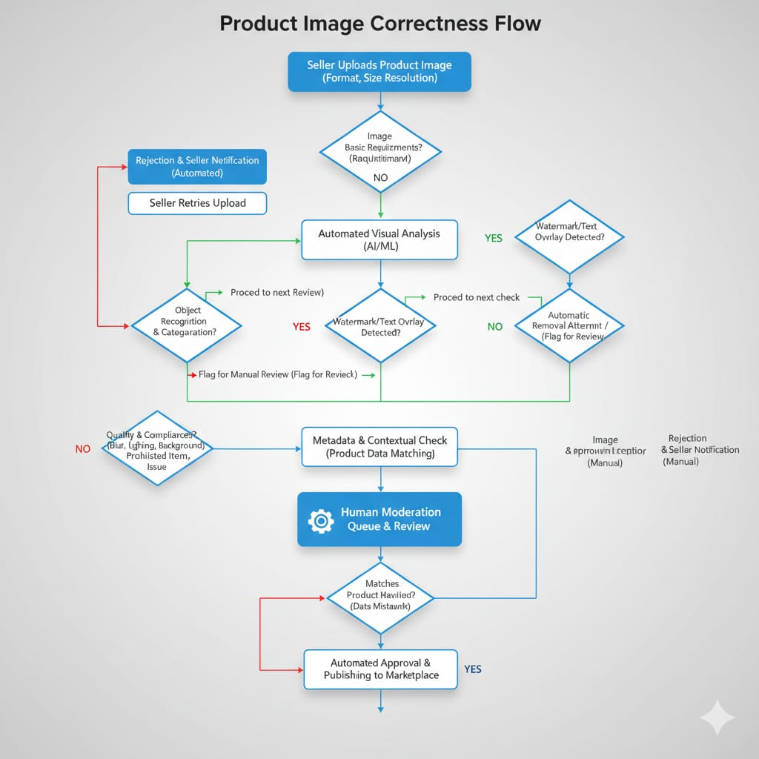
System Architecture:

Slide 6
Algorithm Details:
Algorithm: Image Correctness Verification
Input: Product image I, Product metadata M
Output: Correctness report R
Steps:
Preprocessing:
  Resize image to standard dimensions.
  Apply histogram equalization for brightness and contrast adjustment.
  Remove noise using filters (Gaussian, Median).
Feature Extraction:
  Use CNN-based object detection (e.g., YOLO, Faster R-CNN) to identify key product features.
  Extract color, shape, size, and distinctive patterns.
Metadata Matching:
  Compare extracted features with product metadata.
  Compute similarity score S between detected features and expected features.

Slide 7
Quality Assessment:
- Check resolution ≥ threshold (e.g., 800x800 px).
- Ensure correct orientation and plain background.
- Detect blurriness using Laplacian variance.
Decision Making:
- If S ≥ 0.9 and quality checks passed → Accept Image.
- Else → Flag Image as Non-Compliant and provide corrective suggestions.

Slide 8
Module Description:
Module | Functionality | Input | Output
Image Upload Module | Accepts product images from sellers | Raw product images | Standardized images for processing
Preprocessing Module | Resizes, enhances, and normalizes images | Raw images | Cleaned images ready for analysis
Feature Extraction Module | Detects product features like shape, color, size, and patterns | Preprocessed images | Feature vectors of product attributes
Validation Module | Compares extracted features with metadata and guideline standards | Feature vectors, product metadata | Correctness score & validation results
Quality Assessment Module | Checks resolution, focus, brightness, and background | Preprocessed images | Quality assessment report

Slide 9
References (IEEE Paper format)
A. Krizhevsky, I. Sutskever, and G. E. Hinton, “ImageNet classification with deep convolutional neural networks,” Communications of the ACM, vol. 60, no. 6, pp. 84–90, Jun. 2017.
J. Redmon and A. Farhadi, “YOLOv3: An Incremental Improvement,” arXiv preprint arXiv:1804.02767, Apr. 2018.3.
A. Dosovitskiy et al., “An Image is Worth 16x16 Words: Transformers for Image Recognition at Scale,” arXiv preprint arXiv:2010.11929, Oct. 2020.4.
A. Radford et al., “Learning transferable visual models from natural language supervision,” in Proceedings of the International Conference on Machine Learning (ICML), 2021, pp. 8748–8763.

Slide 10


